Slide 1
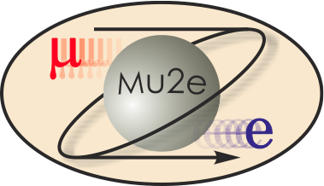
Mu2e Solenoids
Michael Lamm
L2 for the Mu2e Solenoid
July 27, 2015

Slide 2
Mu2e Solenoids
Perform many functions in the Mu2e Experiment
One continuous field, generated by 3 unique superconducting solenoid systems
Need superconducting magnets to achieve required fields
Challenges associated with superconducting magnets
Cryogenic environment
LN2 and LHe
Large stored energies (over 100 MJ)
Has to be removed or absorbed once a quench occurs
High currents (many kA’s)
High voltages when a quench occurs
Large magnetic forces (100 Ton axial forces between magnet elements)
Large material stress (on the order of 50 MPa)
Yet it doesn’t take much of a disturbance to cause a quench..
~100 mJ

Slide 3
Detector vs. Accelerator Magnets
Accelerator magnets (for circular accelerators)
Dipoles and quadrupoles, (sometimes solenoids) Small aperture (100 mm), long (can be 20 meters)
Often sets limit for beam energy (tunnel radius fixed) so designed for high fields ➔ small operating margins
Magnets operated in both ramped and DC modes
Coil immersed in liquid helium
Many interchangeable magnets, pool of spares, relatively easy to swap out if one fails
Detector magnets
Solenoids, toroids very large apertures (meters) and long
Large volume ➔ coils usually conduction (indirectly) cooled
Magnets operated in DC mode only
One of a kind, non interchangeable therefore designed with large operating margins
Mu2e Magnets are somewhere in between (but more like detector magnets)

Slide 4
Interesting facts about charged particles in a solenoid field
Mu2e field is generated from a system of solenoid rings
Charged particles execute a helical orbit in a uniform Solenoid Field
Radius proportional to Pperp
Radius Inversely proportional to Bfield
Helix sense given by particle charge

Slide 5
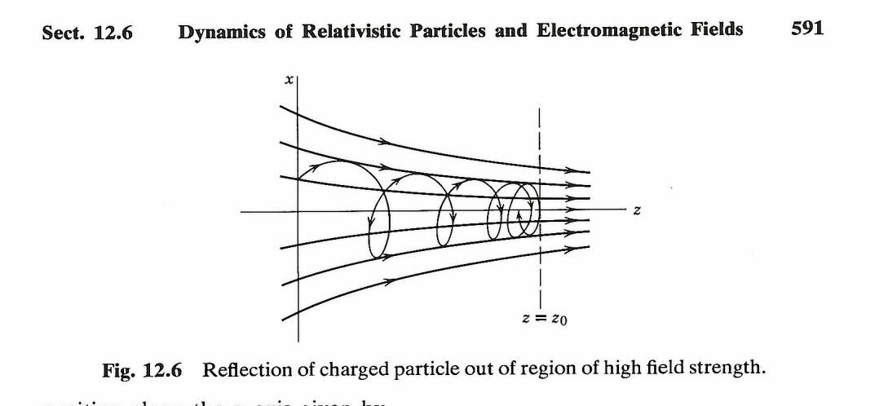
Non-uniform field
With an axial gradient, Bz increasing,
Radius of helix decreases
Vperp increases, Vparallel decreases (V constant since no work)
under certain conditions the particle can actually reverse direction (magnetic mirror) Consequence of Div B = 0
Conversely, if field decreases
Vparallel increases relative to V perp
We use this to increase acceptance and minimize backgrounds
See “Classical Electrodynamics” 2nd edition JD Jackson section 12.6

Slide 6
Non-uniform field II
In a “toroidal” field (with a horizontal orientation, and direction normal to the toroid is direction “s”)
Particles tend to follow the field lines.. Helical centroid follows “s” direction of a curved solenoid…
The centroid of the helix will drift vertically, proportionally to sign and momentum
Problem for Toroidal Tokamaks
We exploit this to eliminate backgrounds
See “Classical Electrodynamics” 2nd Edition JD Jackson section 12.5

Slide 7
Mu2e Experiment
Three solenoids, provide magnetic field for experiment
Strong axial gradient. Reflect and focus (move along) π/μ’s into muon transport
55 Ton Heat and Radiation Shield to intercept target secondaries
Production
Solenoid
Detector
Solenoid
protons
Transport
Solenoid
1 T
2.5 T
4.6 T
1 T
2 T
Sign/momentum Selection
Negative Axial Gradient in S.S. to suppress trapped particles
Graded field to collect conv. e⁻
~Uniform field for e⁻ Spectrometer
24 meters

Slide 8
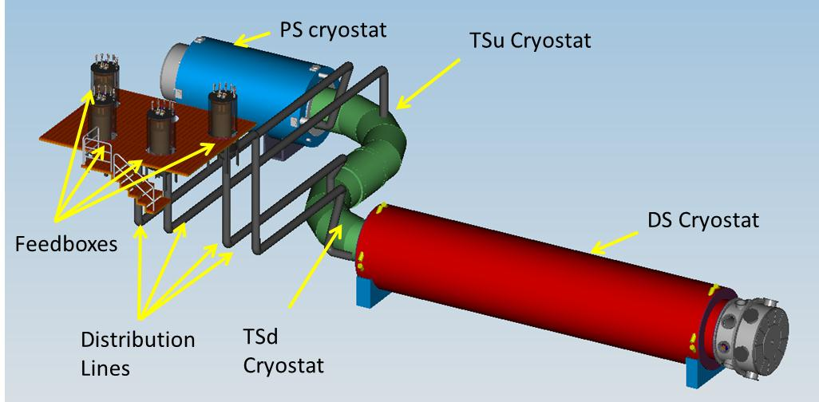
Mu2e Solenoid Scope
Production Solenoid (PS)
Transport Solenoid (TSu,TSd)
Detector Solenoid (DS)
Cryogenic Distribution
~12 meters
Field Mapping
Ancillary Equipment
Installation and commissioning
Cryo distribution box
Power Supply/Quench Protection

Slide 9
Operational Requirements
Reliable superconductor operation at full field life of experiment
Large temperature margin (>1.5K) and Jc margin (>30%) typical of detector solenoids.
Complex thermal mechanical design to obtain and maintain desired field
Individual operation of magnets and cryostats
Cryostats cooled down and powered independently
Individual magnets do not rely on mechanical support of adjacent magnets
Cryogenic operation
Liquid helium Indirect cooling
One Fermilab Satellite refrigerator for steady state operation
Operation due to radiation damage
7 MGy over life of solenoid. (irreversible damage limit of epoxy)
Conductor and stabilizer to operate for 1 year at nominal beam intensity without loss of performance, can be repaired by room temperature anneal

Slide 10
Solenoid Design Features
Solenoid have common design features:
Consist of multiple “solenoid coil modules”. Use Al-stabilized NbTi cable wound either in the “easy way” or “hard way”. Length and # of layers to achieve desired field.
Module has an outer support structure made of Al 5083-O to manage the forces. Cooling tubes, electrical connections located on the outer surface
Coils are “indirectly” cooled with liquid helium. Helium thermally connected to coil through aluminum straps and through structure
The shells are bolted together to form a cold mass assembly.
The coil modules are installed inside of cryostat using axial and transverse supports.

Slide 11
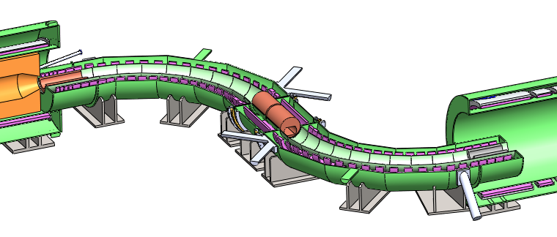
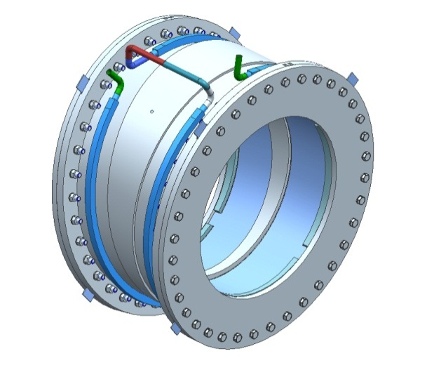
TS Module Overview
It is the basic building block of Transport Solenoids
TSu
Typically 2 superconducting solenoid rings per module
Outer aluminum support shell
Coils indirectly cooled with LHe
27 modules in total
13 in TSu
14 in TSd
TSd
Modules bolted together to form required “S” shaped geometry. Geometry defines the magnetic field

Slide 12
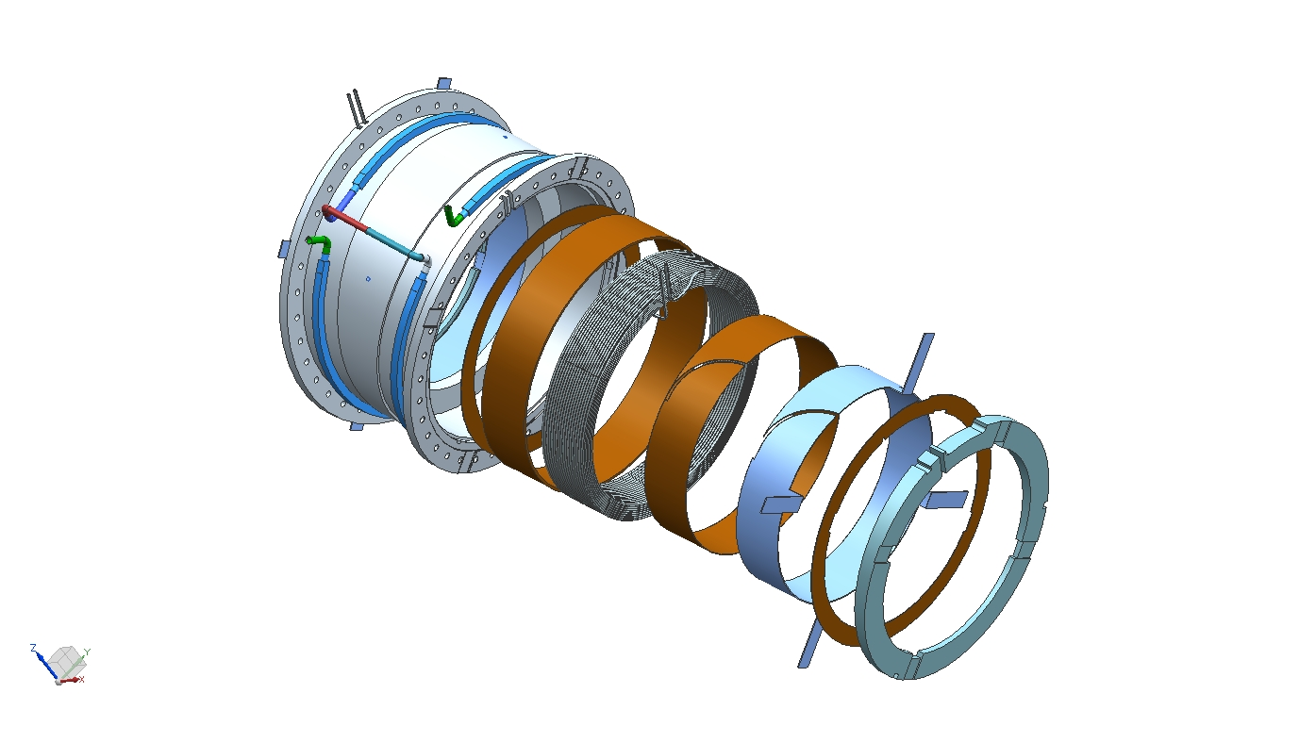

Design – TS Module
coil leads
cooling tube
ground insulation
coil
The coils are epoxy impregnated with the ground insulation and the Al sheet.
pure Al sheet
for coil cooling
wedge

Slide 13
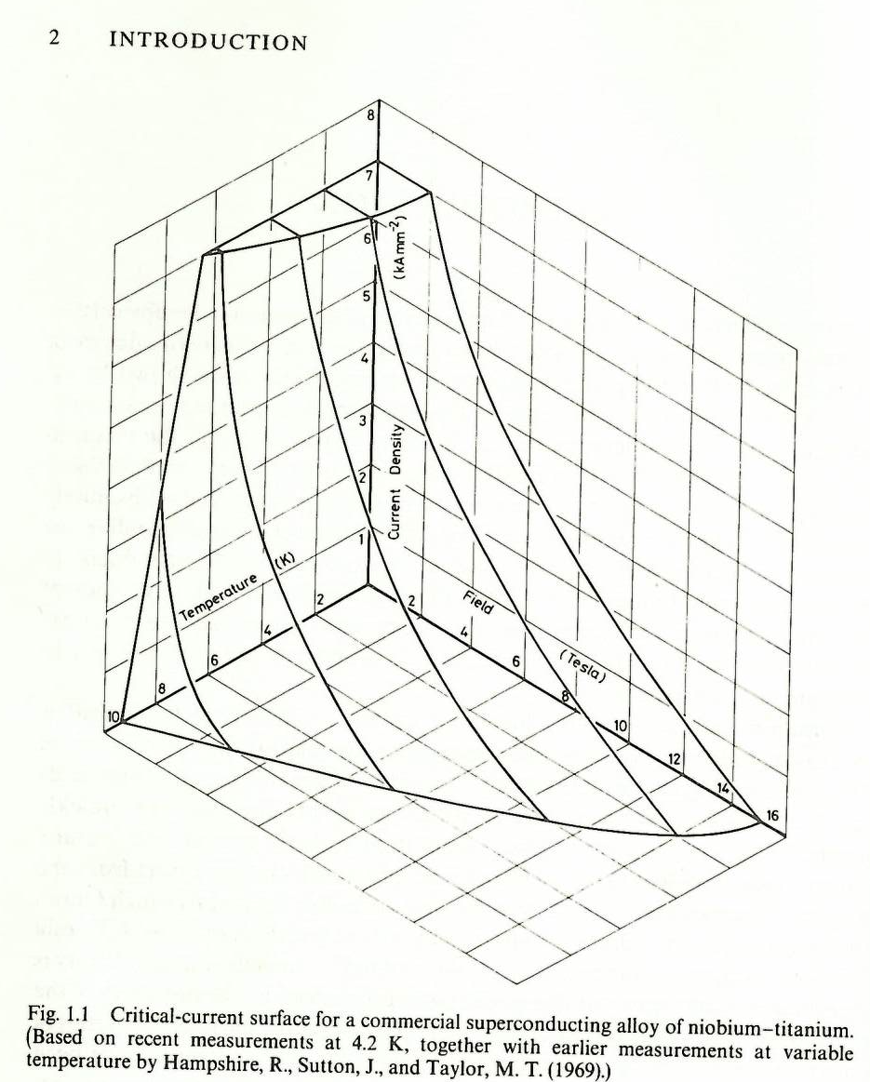
Phase diagram for NbTi
Jc kA/mm²
From “Superconducting Magnets”, Martin N. Wilson
Superconducting condition when conductor is below “critical surface”
Conservative operating conditions using state of the art NbTi Conductor
5 K
5T
2000 A/mm²
Field T
Temp K

Slide 14
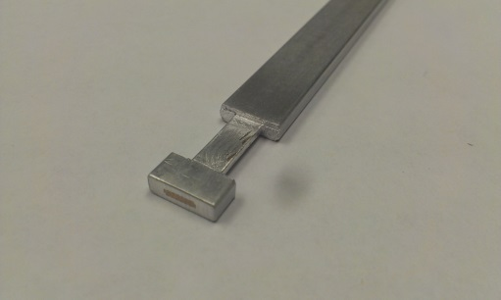
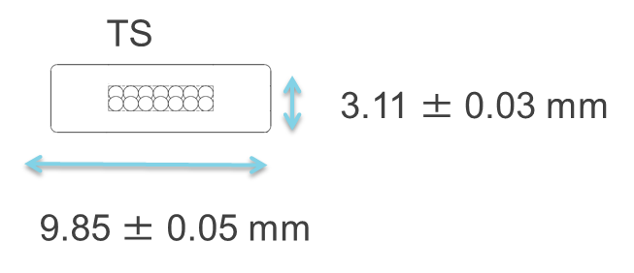
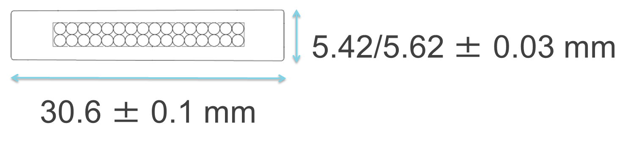
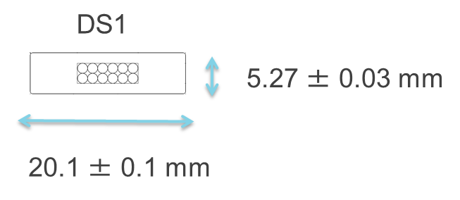
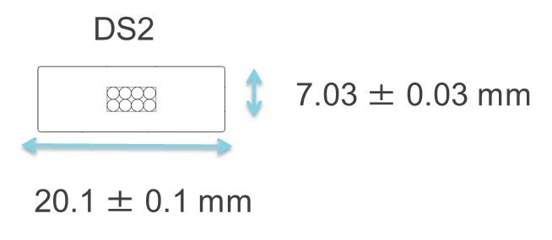
Design: PS/TS/DS1/DS2 Conductor
PS
NbTi Rutherford cable with aluminum co-extruded stabilizer
SC content sized for Specific Magnet Requirement for Current and Temperature Margins
TS/DS: 99.998% aluminum for high electrical and thermal conductivity
PS: use special Ni Doped Aluminum Alloy developed for Atlas Central Solenoid, for high strength and high conductivity
~75 km of conductor required for project
Prototype conductor program successfully completed, production program in progress

Slide 15
Magnet Quench
A quench is an abnormal termination of magnet operation that occurs when part of the superconducting coil enters the normal (resistive) state. (Wikipedia)
Resistive state usually occurs due to a local rise in temperature past the critical surface due to a mechanical disturbance (also beam induced heat…)
If disturbance is small enough, thermal conductivity and electrical conductivity may be sufficient to recover
Otherwise… runaway (quench) condition
Potentially very dangerous state for magnet
Must have very reliable quench detection and subsequent plan for dealing with stored energy

Slide 16
Design magnets to operate well below Critical Surface
With 5.1 K operating temperature
1.8 K temperature margin
44% margin in Ic
Greatly exceeds the requirements of:
1.5 K temperature margin
30% margin in Ic
5.0K
I/Ic(5.1K)=56%

Slide 17
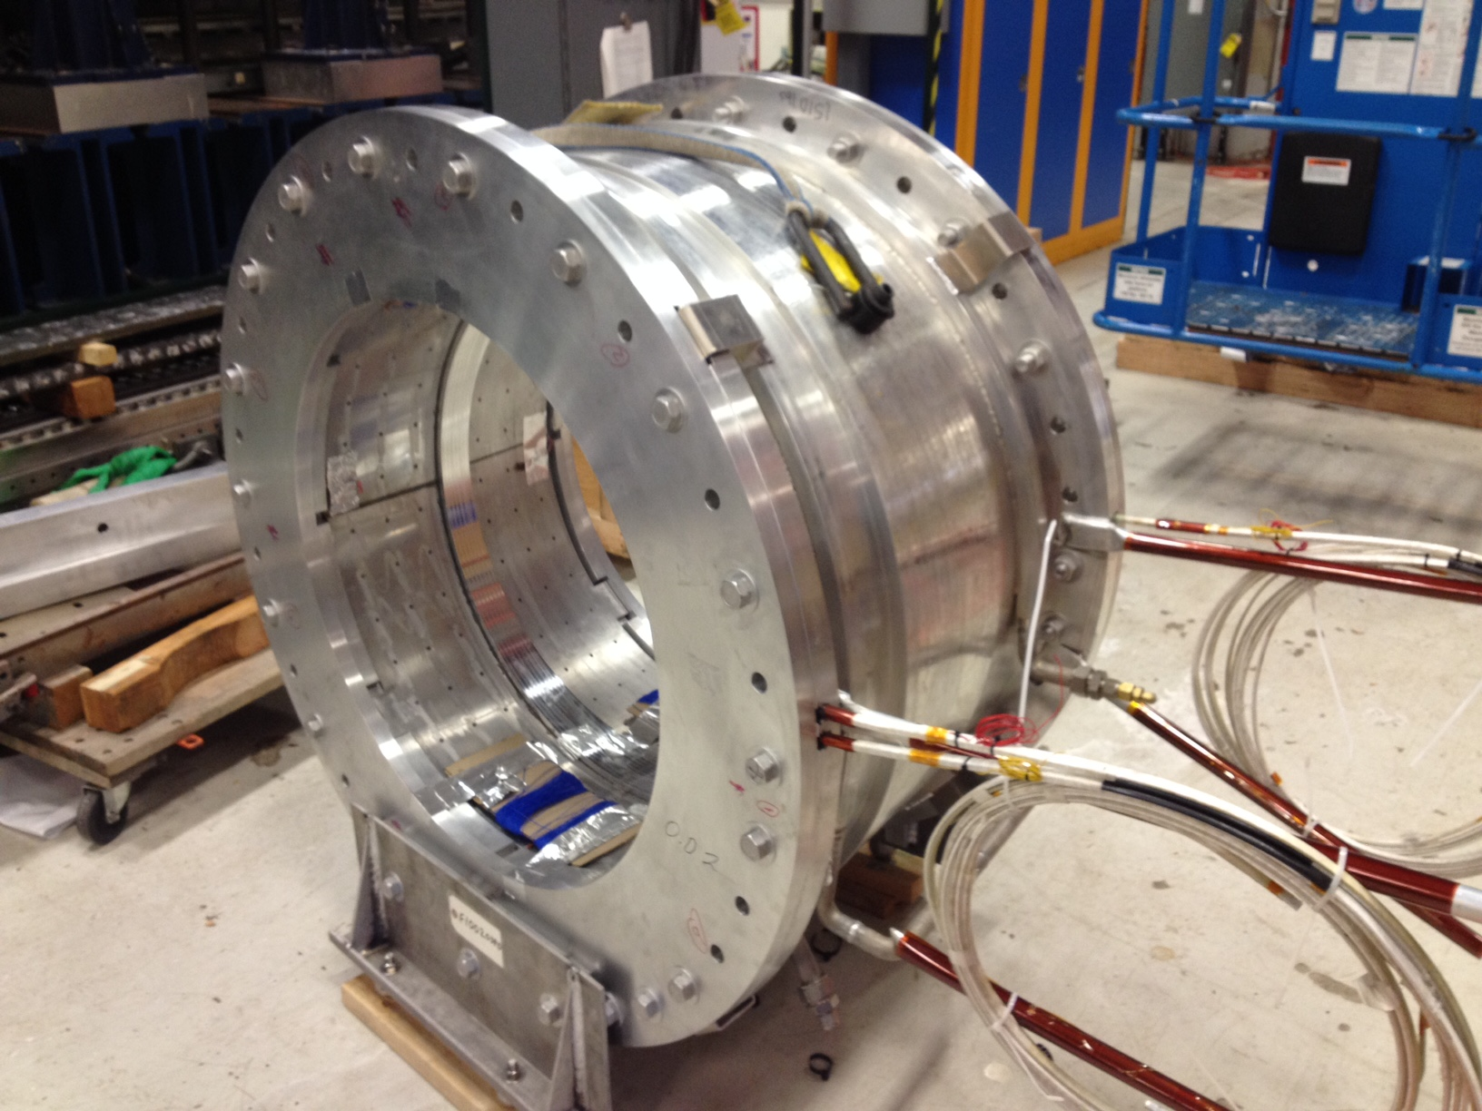
TS Prototype Coil Module

Slide 18
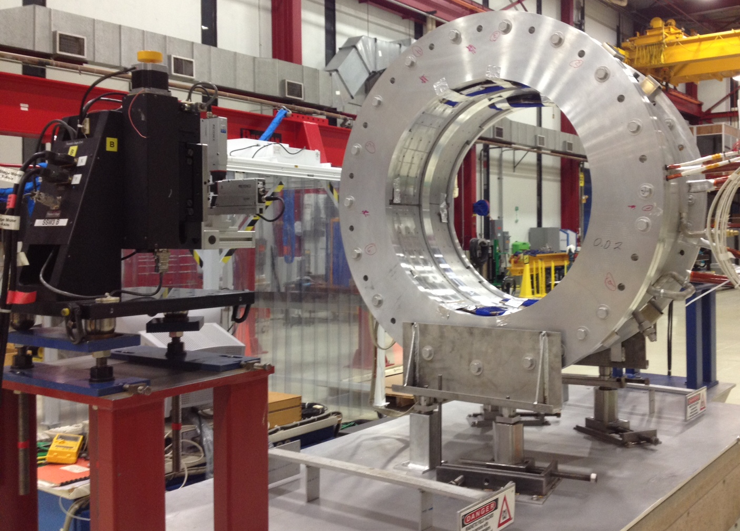
TS Prototype Coil
SSW to determine dual coil magnetic axes

Slide 19
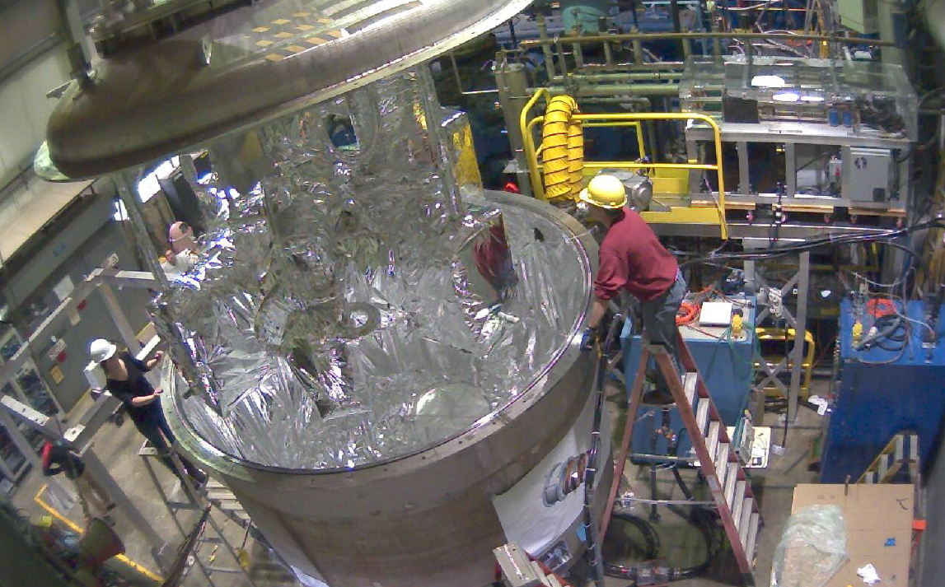
TS Prototype Insertion into Cryostat at CHL
TEST COMPLETED
PASSED!
Will be removed from test cryostat in ~2-3 weeks

Slide 20
Future Mu2e-like experiments….
Need to significantly increase muon yield….
More intense proton beam.. more heat/radiation to production solenoid (PS) from production target secondaries
Higher field PS to improve collection efficiency
More stress on PS!
If we are limited by our present PS only options are to
Use better (also more expensive) secondary beam absorber (probably Tungsten)
Lower LHe temperature
Counteract increased heat load from secondary
Perhaps allow us to increase current
Eventually we will be limited by rad harness of epoxies and insulation and aluminum stabilizer
May consider a new PS made with High Temperature Superconductor (HTS) which can operate at a higher temperature

Slide 21
Additional slides

Slide 22
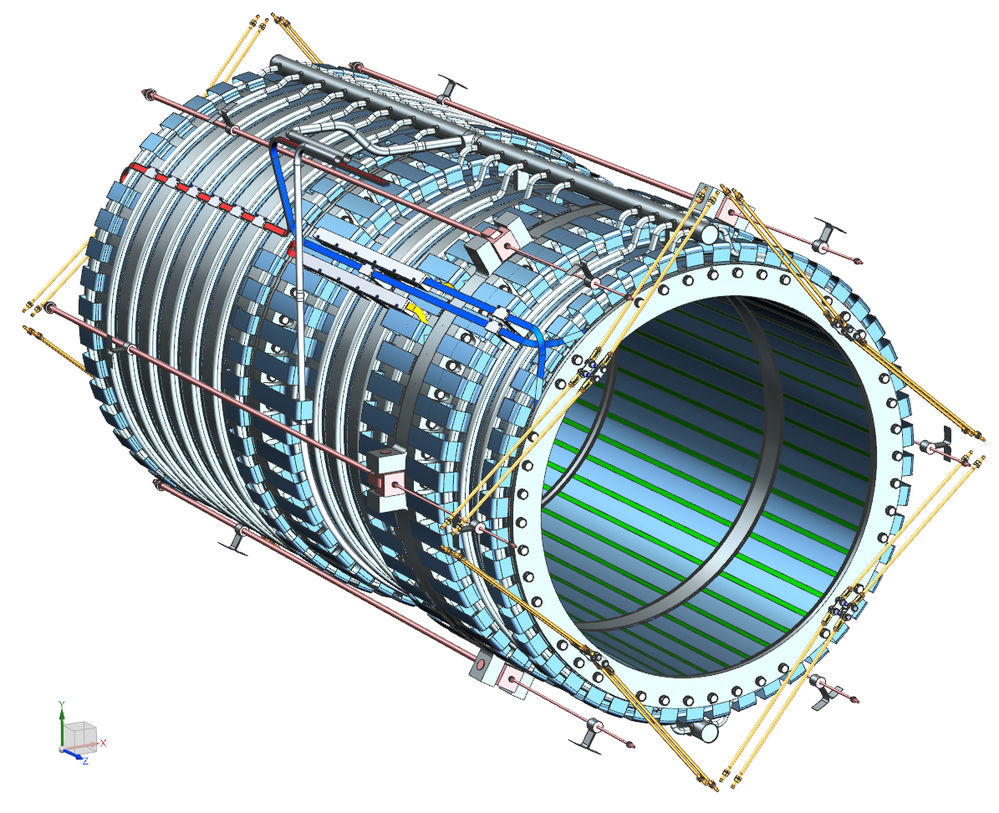
PS Design - cold mass suspension system
Axial suspension:
6 asymmetric pairs of Inconel-718 rods;
Belleville springs at each rod’s end to compensate the thermal contraction.
Radial suspension:
4 pairs of Inconel-718 rods at each end;
Half of the rods is loaded through the Belleville springs to compensate the thermal contraction.

Slide 23
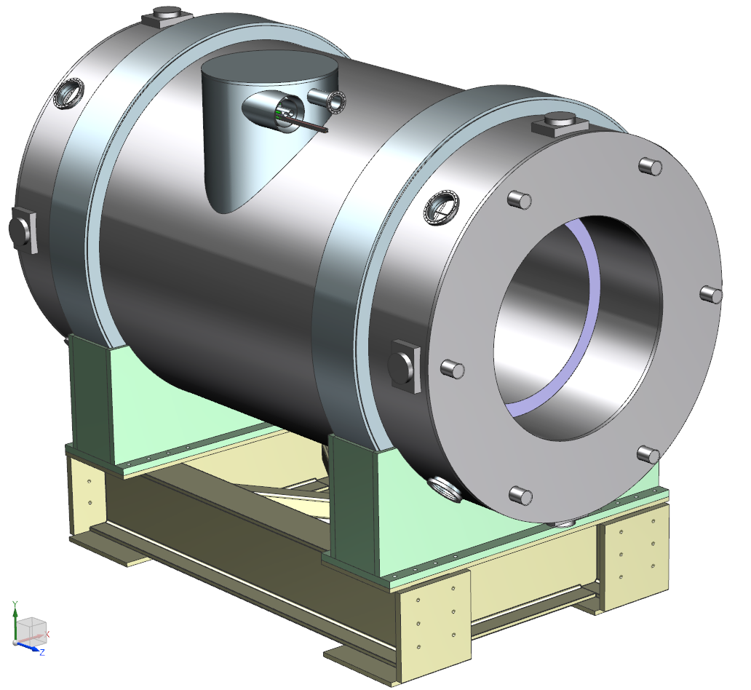
Design: vacuum vessel & support frame
Provides insulating vacuum and attachment points for all components (in and out);
Transfers all loads to ground:
Cold mass and LN₂ shield weight through the radial supports;
Lorentz forces through the axial supports;
HRS weight through the inner shell (~55 tonnes);
Provides interfaces to:
HRS upstream, downstream;
Transport solenoid;
Transfer line;
Instrumentation line;
Vacuum system.

Slide 24
Design: Detector Solenoid (DS)
Detector Section
Gradient Section
1.8 m Aperture Operating Current ~6kA
Gradient section 2T➔ I T field
Spectrometer section 1 T field with small axial gradient superimposed to reduce backgrounds
11 Coils in total
Axial spacers in Gradient Section
Spectrometer section made in 3 sections to simplify fabrication and reduce cost
PS uses similar fabrication technology

Slide 25
General Solenoid Requirements
Magnetic field requirements, described in the Mu2e Technical Design Report and in supporting documents, are complex. Generally speaking field must meet the following:
Straight Sections
Negative monotonic axial gradient to prevent trapped particles. (potential source of backgrounds)
Toroidal Sections
Matched to central collimator geometry for muon momentum selection
To verify that the solenoid system meets the field performance standards
Generate field maps within coil fabrication tolerances
Field Maps are vetted with collaboration for muon transmission, background generation and tracking efficiency and resolution

Slide 26
Solenoid Schedule
CD-3a Conductor
CD-3b Building and TS Coil Modules
CD-3c Everything Else….
Large in-house activities
CD-3a
CD-2/3b
CD-3c
CD-4
PS Prototype Conductor
PS Conductor
KPPs Satisfied
PS Final Design in Industry
Build PS
TS Prototype Conductor
TS Conductor
Build TS
DS Prototype Conductor
DS Conductor
DS Final Design in Industry
Build DS
Detector Hall Construction
Muon Beamline/Solenoid Infrastructure
Solenoid Installation and Commissioning
Q3 | Q4 | Q1 | Q2 | Q3 | Q4 | Q1 | Q2 | Q3 | Q4 | Q1 | Q2 | Q3 | Q4 | Q1 | Q2 | Q3 | Q4 | Q1 | Q2 | Q3 | Q4 | Q1 | Q2 | Q3 | Q4 | Q1 | Q2 | Q3 | Q4 | Q1 | Q2 | Q3 | Q4
FY14 FY15 FY16 FY17 FY18 FY19 FY20 FY21

